Slide 1


Support & Revision Evening for Parents and Carers

Slide 2
Revision

Slide 3

Barriers to Revision
Extensive research is pretty conclusive about this - most students use ineffective revision methods
Students are not good at knowing which strategies are effective
Students think revision means hours and hours of reading notes or revision guides

Slide 4
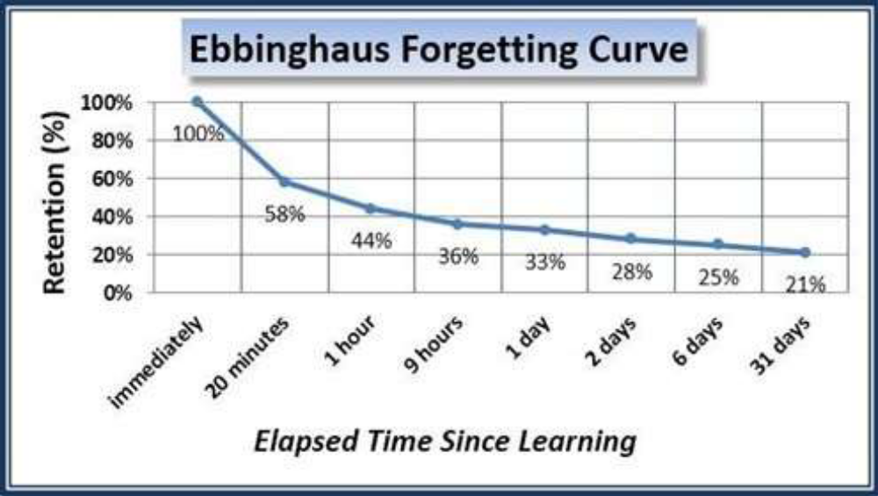
Revision is necessary, in fact it is crucial. Look how easily we forget things:

Slide 5
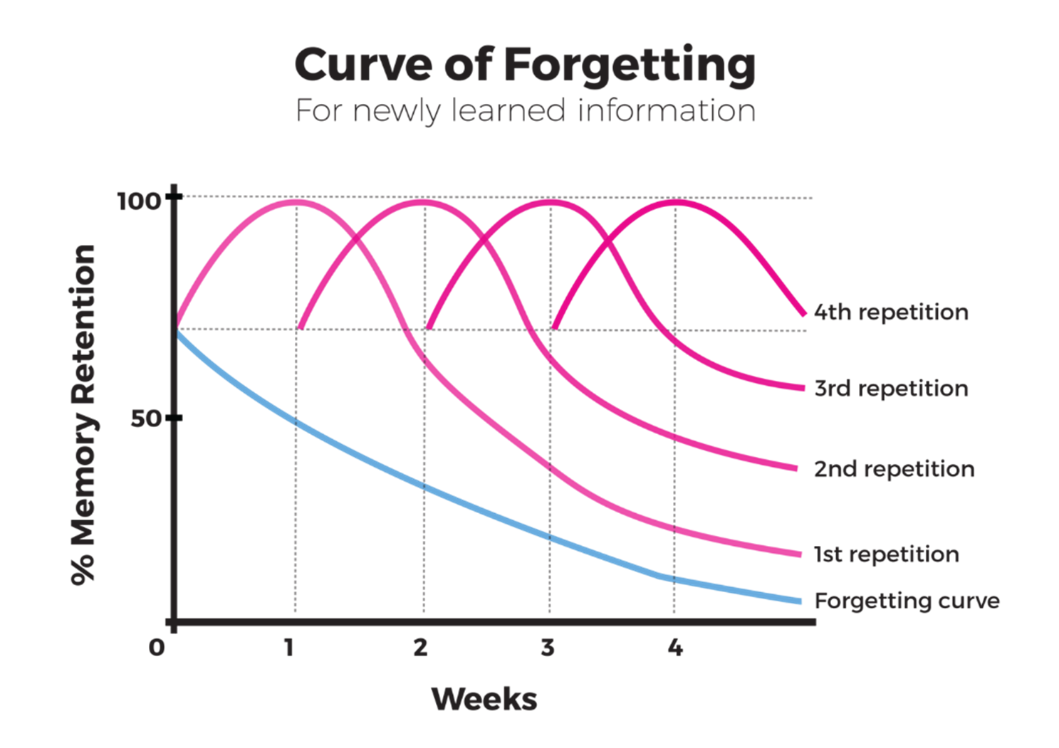

Slide 6

How does the brain remember?
Notes:
Introduce the ‘neuroscience nerds’ carefully so that students don’t focus on their ‘nerdiness’ and forget to listen to the science of memory.

Slide 7
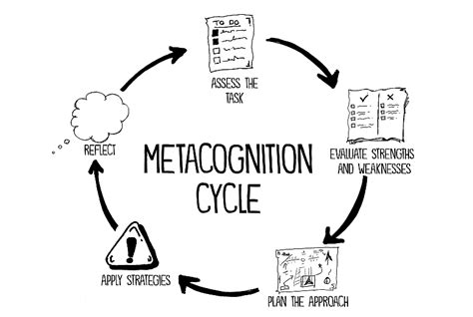

Retrieval Practice Top Tips
It is the most efficient way to move knowledge to long term memory
Apply this strategy to prepare for mocks and use the mocks to learn about exam technique and to reflect on preparation
Test themselves little and often
Interleave topics and subjects for the best results
Flashcards are efficient and quizzes are fun, use both methods

Slide 8
Which revision strategies work best and why?

Slide 9

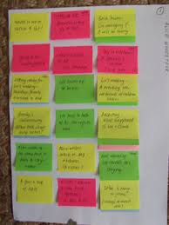

Top 10 Techniques and Impact on Progress
Summarising - writing summaries of texts - LOW
Highlighting/underlining - LOW
Re-reading - LOW
Keyword mnemonics - choosing a word to associate with information - LOW
Imagery - forming mental pictures while reading or listening - LOW

Slide 10
Top 10 Techniques and Impact on Progress
Elaborative interrogation: being able to explain a point or fact - MODERATE
Self-explanation: how a problem was solved - MODERATE
Interleaved practice: switching between different kinds of problems – MODERATE
Practice testing: self-testing to check knowledge - especially using flash cards - HIGH
Distributed practice: spreading out study over time - HIGH

Slide 11
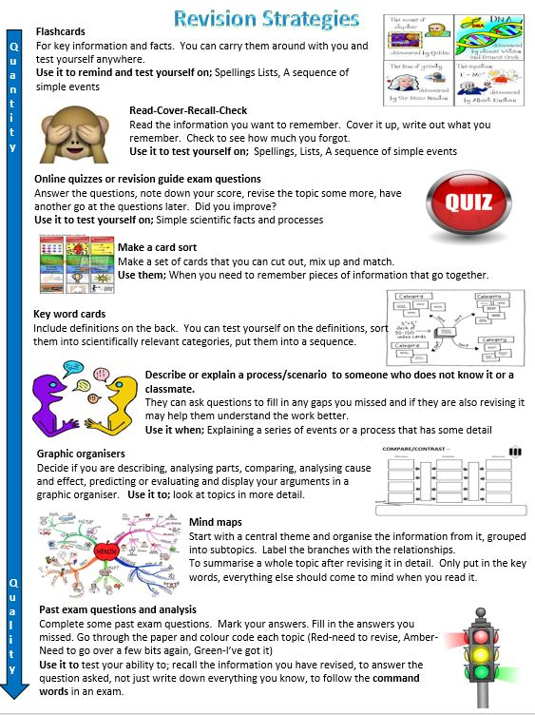

Slide 12

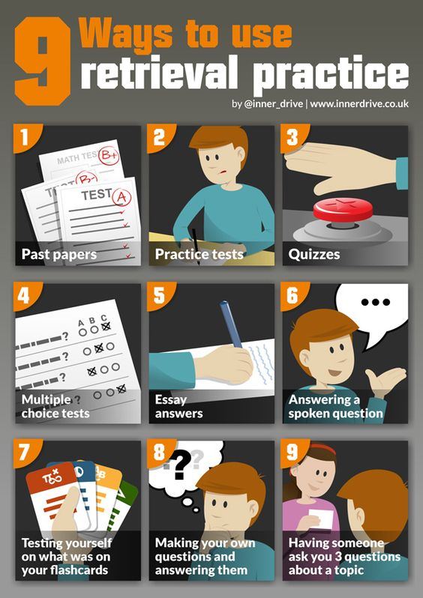

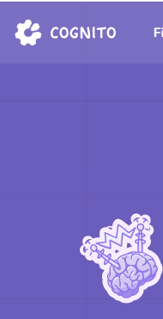
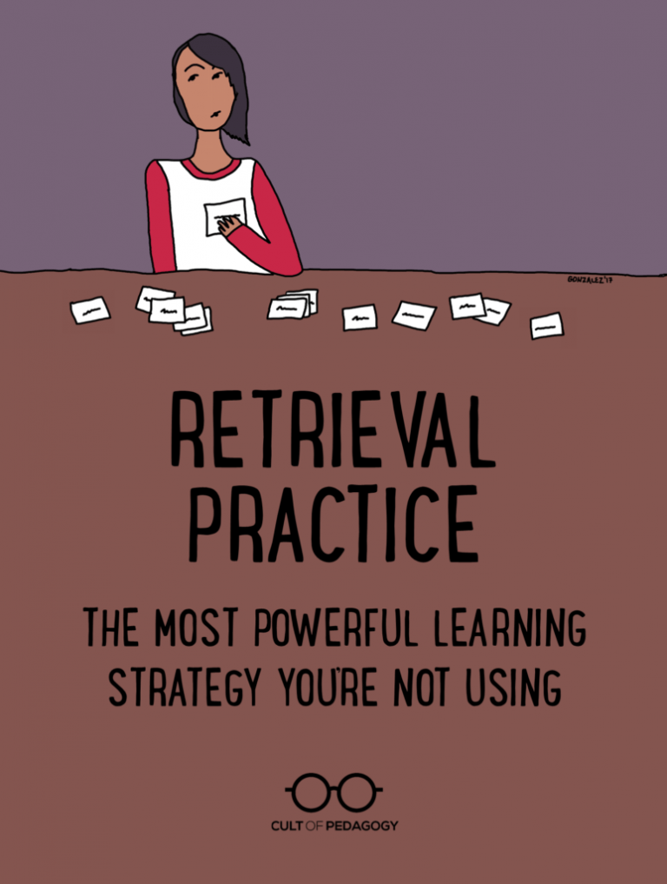






Slide 13
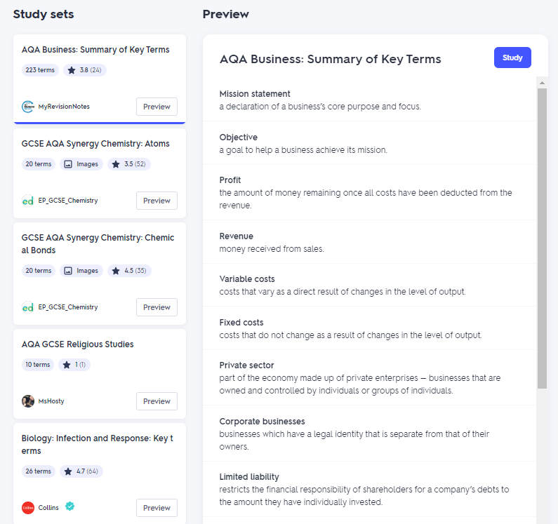
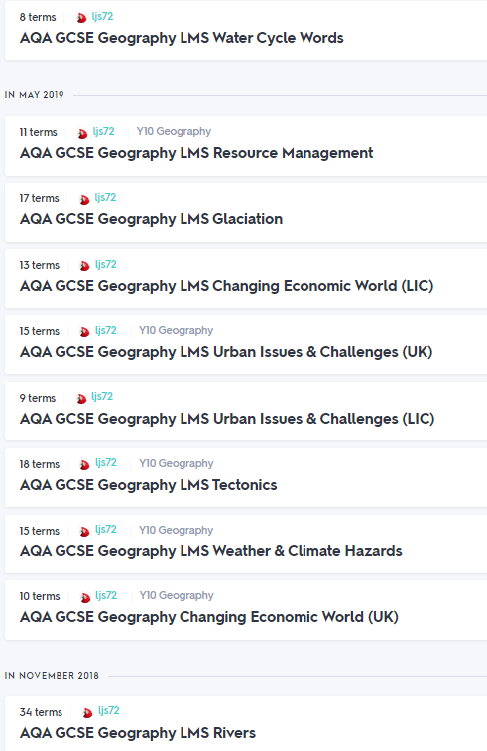
Flash cards and ways to improve memory
Notes:
Just some samples of content available for different subjects

Slide 14
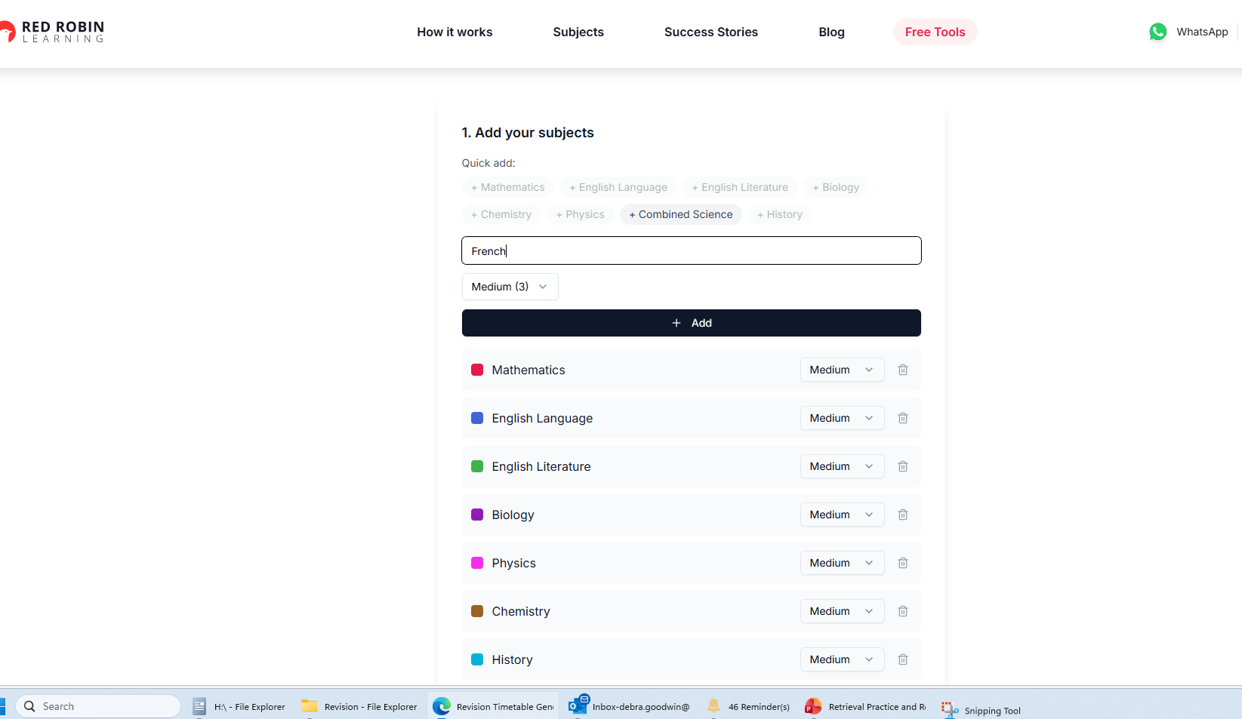
Planning a revision timetable –free tool
Revision Timetable Generator | Free GCSE & A-Level Planner

Slide 15
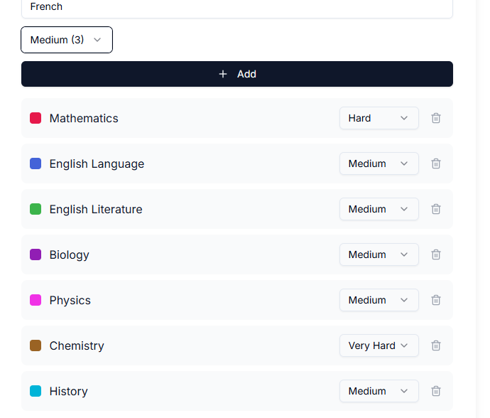
Personalise it

Slide 16
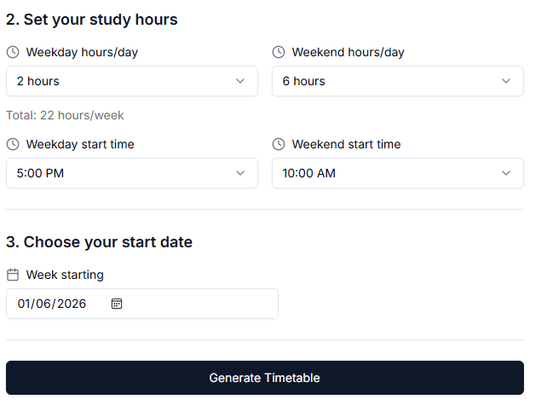
You can tell it what time you want to start studying and for how long each weekday and weekend

Slide 17
Memory Methods - Retrieval Practice
Flash cards- test yourself / test each other
Quizzing using technology (see next slide for websites)
Exam questions do them and repeat them
Mind-maps – read, cover, recreate
Parent / carer / peer quizzing/testing
Don’t use notes/aids when completing retrieval to make sure it sticks in long term memory!

Slide 18
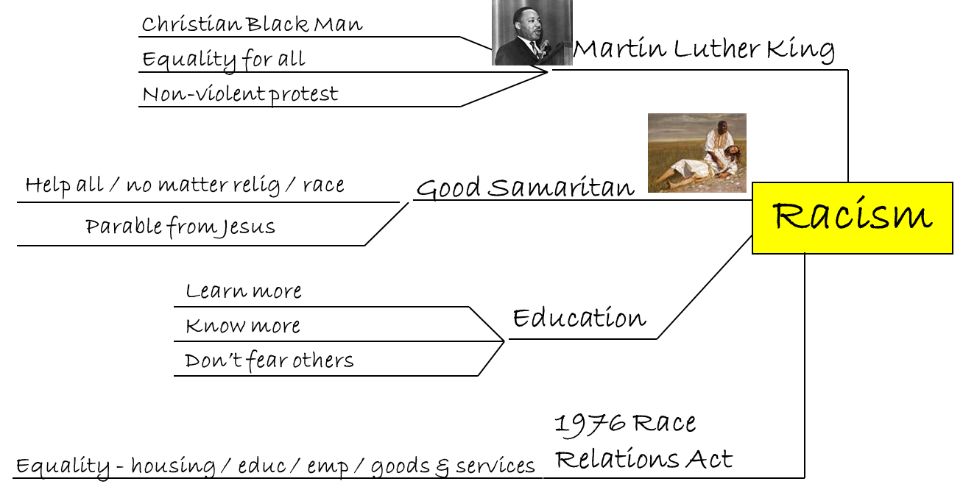
Mind Maps

Slide 19

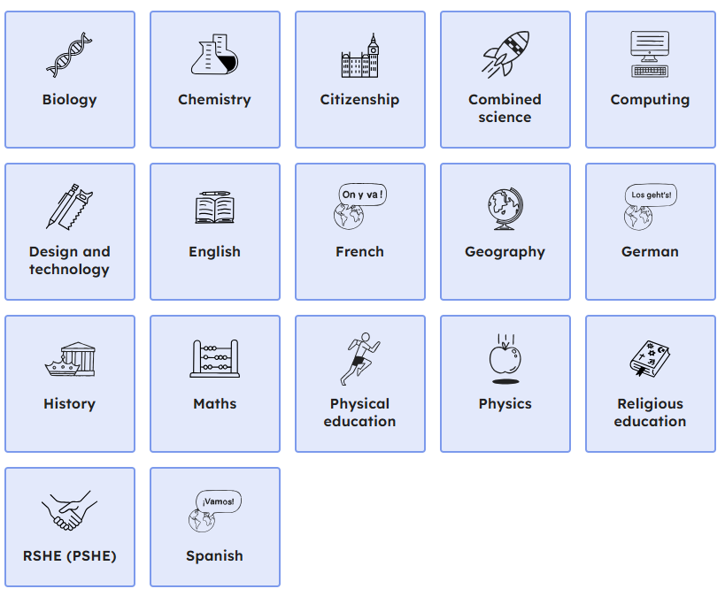
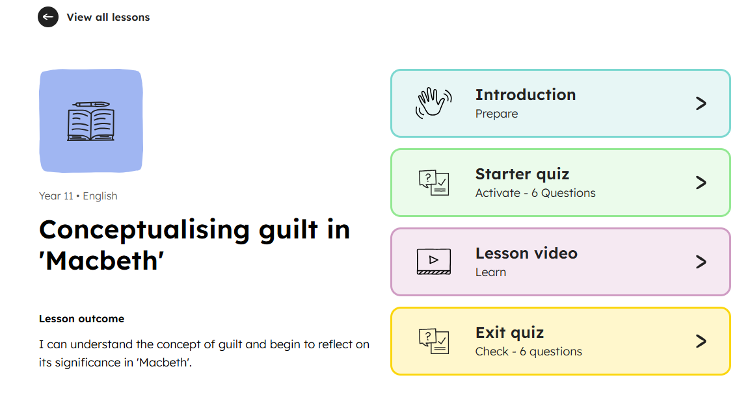

Slide 20
Using AI for Revision
Potential Benefits
Generating quiz questions to check knowledge
Creating study materials and summaries
Providing personalised feedback
Offering different explanations of complex topics
Personalising the questions to the individual
Breaking down difficult content or rephrasing questions into easier to understand language

Slide 21
Using AI for Revision
Potential Problems
Reliability and accuracy , AI is only as accurate as the information it is trained on.
AI tools can generate responses that are incorrect or inappropriate
Data privacy issues if students enter personal data
The more specific the prompt students give to AI, the more likely they will get a useful response. Make sure things like which exam board and which specification are given

Slide 22
Revision Top Tips and Planning
ALL students need to plan their revision for the Mock Exams
Use the booklet of tips, they have one and you have one
Support them to plan a timetable of how they will use their time at home
Encourage attendance at all relevant Year 11 lunchtime booster sessions

Slide 23

Planning Revision
Put aside distractions
Manageable chunks
20-30 minute sessions
Rewards
Change topic/subject
Avoid burn out

Slide 24
Top Tips for Parents/Carers
Stick to routines
Create a revision plan with your
child well in advance of any
examination period
Regular reviews of how your child
is getting on but ask for evidence
Put in place if not already
‘rules for homework/revision’
Provide coloured pens/post-it notes/
coloured card/ paper clips etc
Encourage and praise
at every opportunity
Put key dates in your own diary
Become a ‘revision buddy’
Ensure full attendance - 95% attendance
sounds good but what does it
actually mean?
  ½ day of lessons missed each week
  2 weeks of lessons missed each year
After an exam ask how it went
(respect your child’s wishes to deal
with feelings in their own way but
remember ‘tomorrow is another day’)
Become ‘au fait’ with what support
is available on the Internet and Moodle
Provide favourite snacks as ‘carrots’
Encourage regular breaks
particularly outdoors
Put up the exam timetable
somewhere prominent and
cross off each exam
when completed
Agree balance between
work and social time
Be aware of the revision/additional
sessions on offer at school
Use a reward structure to motivate

