Slide 1


Mental Health
Now make a list of them in your book!
Do you remember the Five Ways to Well-being?
Instructions: List as many as you can on your white board.
Notes:
Answer on a click

Slide 2

Mental Health
Mental health, mental well-being, continuum,
How might the way we learn and your academic performance be further improved by reviewing our mental health?
How far is it true that our mental health isn’t fixed? Use examples to help explain your thoughts
Why is mental health as important as physical health, and how do they affect each other?
Notes:
What experiment would you design to prove that mental health isn’t a case of ‘good’ or ‘bad’ mental health?

Slide 3
On your whiteboard, write down words and phrases that you think of when you think about ‘mental health’.
Notes:
Ask them to decide if they are mostly positive words go to the doing well end and negative to the not doing so well.
Ask the to look at the word.
Ask their tables to then discuss why someone may not want to disclose they are feeling like they are not coping.

Slide 4


Mental health describes your mental state such as how you are feeling and how well you can cope with day-to-day life.
Notes:
Ask the class ‘what isn’t mental health?’ examples may include ‘an absence of mental illness’, ‘feeling great all the time’, ‘not feeling sad/bad’ etc

Slide 5

Instructions: Copy and complete the sentence starter into your book:
‘The term mental health continuum describes…’
Further Challenge: How may the continuum affect your mindset?
Notes:
https://www.youtube.com/watch?v=zDr1pWS-PQg 2 minutes long It is Australian and sign posts support not accessible to our students

Slide 6

Where/who could these people ask for support?
Sally is starting to feel isolated from her friends; she doesn’t feel like she fits in with them anymore and it is on her mind a lot.
Jarad is worried about his mum and hasn’t been able to focus well in lessons for a couple of weeks.
Peter is concerned about his body. He seems to have put on some weight lately. His mum said not to worry as his brother did the same then ‘shot up’. He has stopped eating at lunch times and feels very tired in the afternoons.
Instructions: Read each of the three case studies and with a neighbour discuss where these people could seek help from.
Notes:
A way to recap where the students may seek support and guidance.
Some examples: Form Tutors, PSAs, HOY, Family, Childline, MIND, Changing Lives, School Nurse, GP.

Slide 7
Where to go for help and support
Remember, you can go for help from:
Teachers,
Head of Year,
Pastoral Assistant,
Your family,
Changing Lives team,
Childline,
Mind,
friends
Instructions: Write some of these down in your book

Slide 8
‘The internet is a really useful place to seek advice when you are embarrassed to talk to an adult.’
Is this always true?
Make sure you can justify your response.

Slide 9
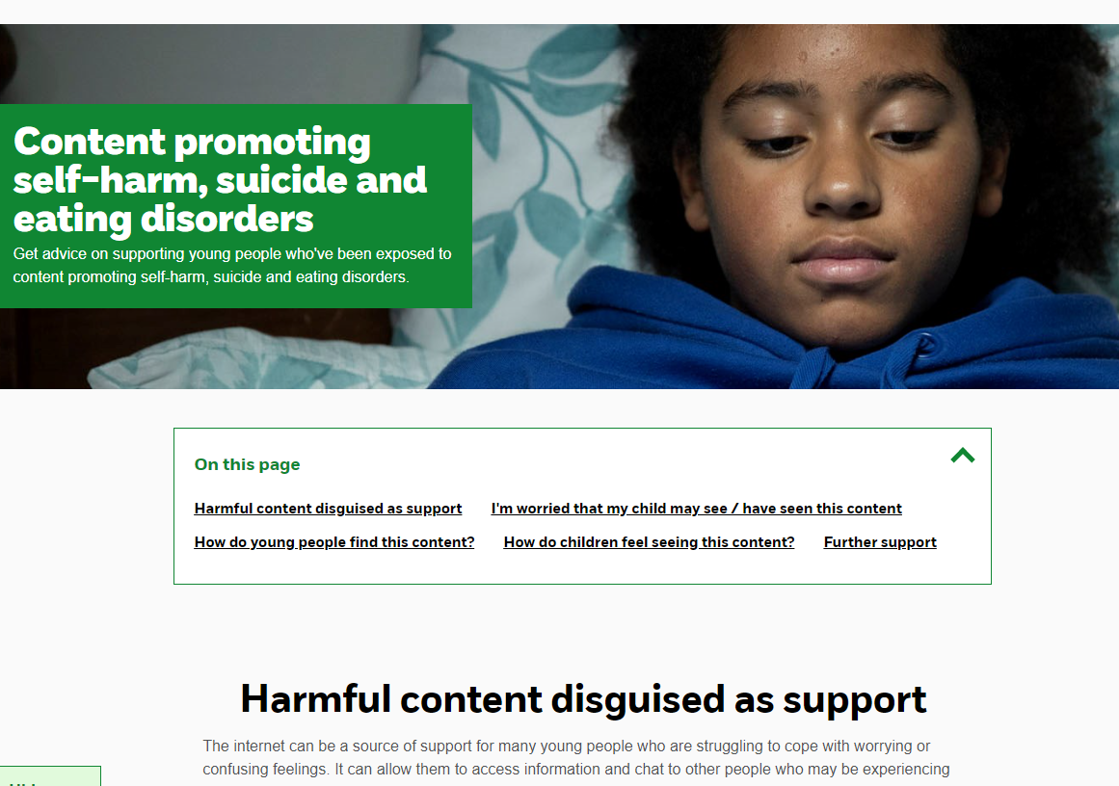
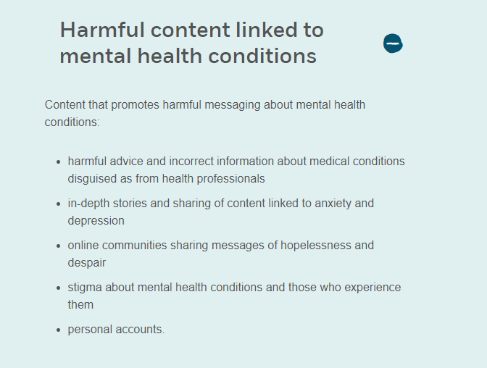
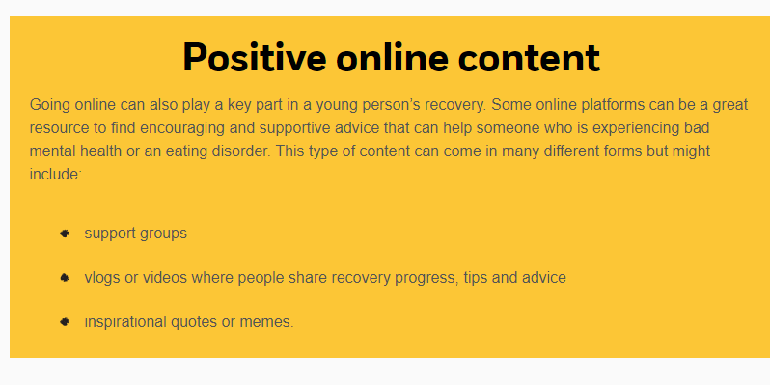

Slide 10
Three pen answer!
Use the first colour pen / pencil to silently write YOUR OWN ideas around the question.
Signs someone may need to seek support for their mental health
Then pair with people near you to share and add those ideas in another colour pen.
Finally, share with the whole class and add these ideas in another colour pen.
Notes:
Signs and symptoms of mental illness can vary, depending on the disorder, circumstances and other factors. Mental illness symptoms can affect emotions, thoughts and behaviours.
Examples of signs and symptoms include:
Feeling sad or down
Confused thinking or reduced ability to concentrate
Excessive fears or worries, or extreme feelings of guilt
Extreme mood changes of highs and lows
Withdrawal from friends and activities
Significant tiredness, low energy or problems sleeping
Detachment from reality (delusions), paranoia or hallucinations
Inability to cope with daily problems or stress
Trouble understanding and relating to situations and to people
Problems with alcohol or drug use
Major changes in eating habits
Sex drive changes
Excessive anger, hostility or violence
Suicidal thinking

Slide 11
Signs and symptoms of mental illness can vary, depending on the disorder, circumstances and other factors.
Feeling sad or down
Confused
Unable to concentrate
Excessive fears or worries
Extreme feelings of guilt
Extreme mood changes of highs and lows
Withdrawal from friends and activities
Significant tiredness, low energy
Problems sleeping
Detachment from reality (delusions), paranoia or hallucinations
Signs someone may need to seek support for their mental health
Inability to cope with daily problems or stress
Trouble understanding and relating to situations and to people
Problems with alcohol or drug use
Major changes in eating habits
Sex drive changes
Excessive anger, hostility or violence
Suicidal thinking
Notes:
Signs and symptoms of mental illness can vary, depending on the disorder, circumstances and other factors. Mental illness symptoms can affect emotions, thoughts and behaviours.
Examples of signs and symptoms include:
Feeling sad or down
Confused thinking or reduced ability to concentrate
Excessive fears or worries, or extreme feelings of guilt
Extreme mood changes of highs and lows
Withdrawal from friends and activities
Significant tiredness, low energy or problems sleeping
Detachment from reality (delusions), paranoia or hallucinations
Inability to cope with daily problems or stress
Trouble understanding and relating to situations and to people
Problems with alcohol or drug use
Major changes in eating habits
Sex drive changes
Excessive anger, hostility or violence
Suicidal thinking

Slide 12
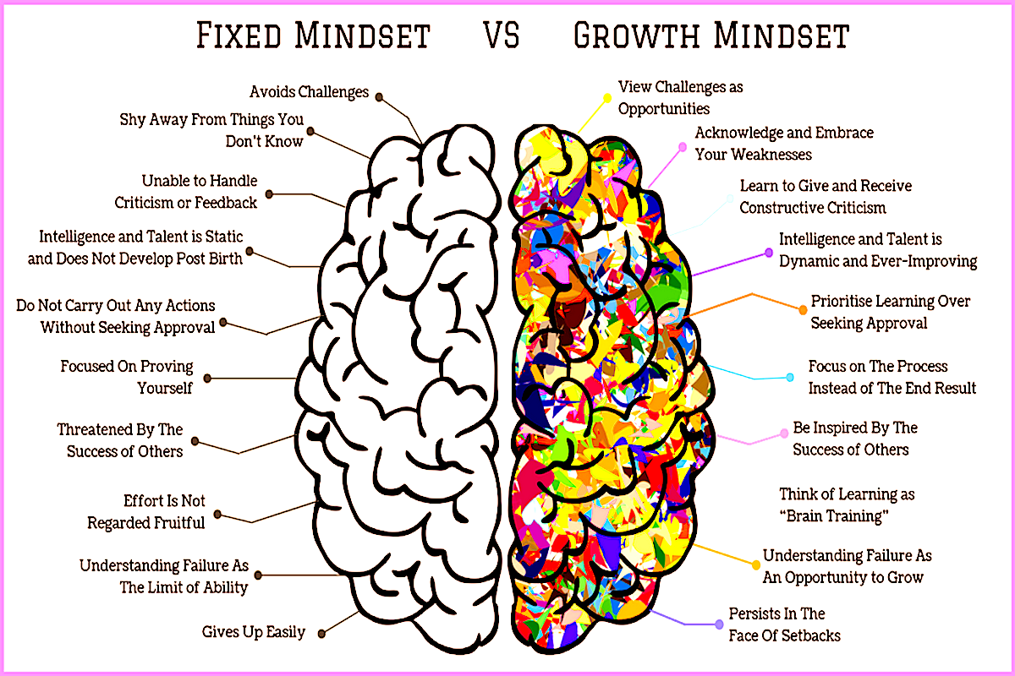
Mindset and mental health- what is the link?
Notes:
If the students remember that mental health is a continuum and reflection is a key part of the metacognition cycle. They should be able to refer to the 7 Habits of effective teenagers knowledge from term one.
Decades of empirical studies have shown that metacognition is effective at decreasing addictive behaviours and improving emotional well-being. Metacognitive training has demonstrated significant benefits in education and we should always try to link these ‘well-being’ lessons to learning to learn work.

Slide 13
Mental health is on a continuum
I am coping well and enjoying my life
I am not coping and I am not happy
I am managing OK
Not doing so well
Doing well
Notes:
A doing task- the three continuum heading slide need printing off in colour on card for staff to use- a set per teacher-
Its important to note that having a mental illness does not mean someone cannot have good mental health, and equally an individual without a mental health problem can experience poor mental health and distress. We all experience things differently.
Overall, your mental health goes up and down all the time, whether or not you have a mental health diagnosis. It changes depending on what’s happening in your life and what capacity you have to cope. The following is designed as a physical continuum task. Have the three headings across one wall and ask the students to place themselves on the continuum where they feel the case study person is on the continuum.

Slide 14
Where is Tracy on the continuum?
Tracy is 15 and is really struggling to cope with the pressure of her GCSE exam preparation. She feels behind with everything and is unable to get to sleep at night. Tracy hasn't told anyone that she is struggling but her friends have noticed that she has lost some weight and doesn't hang out with them anymore.
Doing well
Not doing so well
Notes:
*ask students to mark on their continuum where Tracy is*
Whole class feedback

Slide 15
1 month later. Where is Tracy on the continuum now?
Tracy has talked to one of her closest friends about how she’s feeling. Together they went to see the school nurse who got some help for Tracy. She’s still worried about her GCSE’s but feels that she’s better able to cope.
Doing well
Not doing so well
Notes:
Ask young people to decide if Jenny moves stays where he is or moves. Get them to consider how far he moves along the continuum.
Jenny might be feeling a bit better now, but she could still struggle again if the exam pressure gets worse, or if her friends stop being so supportive. She will likely need a bit of time to feel 100% again.
Both Michael and Tracey ended at similar points.

Slide 16
Where is Michael on the continuum?
Michael is 15 and struggles with anxiety. Michael has started receiving support from the school nurse and now feels like he is better able to manage his mood. He has gone back to football every Tuesday night, is back on top of his school work and has let his friends know that he was struggling.
Doing well
Not doing so well
Notes:
Students could have this printed? Or whole class activity?
*ask students to mark on their continuum where Michael is*
Whole class feedback

Slide 17
1 month later. Where is Michael on the continuum now?
Michael receives a disappointing grade in his Maths test that he worked really hard for and his pet rabbit has died. His friends are still supportive but he’s starting to withdraw from them and they’ve decided to leave him be “to get over it”.
Doing well
Not doing so well
Notes:
Ask young people to decide if Michael stays where he is or moves. Get them to consider how far he moves along the continuum.
Michael might struggle (as anyone would), but that doesn’t mean he will definitely become unwell. Maybe he copes best by taking time alone. Maybe a lot of us would react like this after a pet dies. It might help if his friends kept it touch.

Slide 18
Mental Health Continuum:
Mental health, mental well-being, continuum,
How might the way we learn and academic performance be further improved by reviewing our mental health continuum?
How far is it true that our mental health isn’t fixed? Use examples to help explain your thoughts
Why is mental health as important as physical health? Explain how they affect each other.
Notes:
What experiment would you design to prove that mental health isn’t a case of ‘good’ or ‘bad’ mental health?

Slide 19
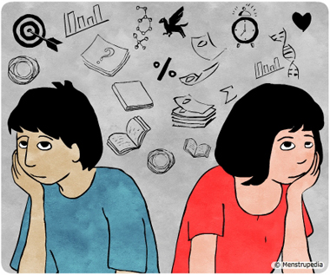
What is does puberty mean?
Where does puberty start?
Name two changes that occurs to boys and girls
Name on hormone involved in male puberty changes
Name one hormone involved in female changes
Name two changes that only occur to boys
Name two changes that only occur to girls
How may puberty affect the way you feel?
What is our theme for next week?
Answer the questions to reveal a portion of the picture to uncover what we shall be learning about next lesson...
Notes:
The emotional impact of puberty and how communication with our care givers may be affected by these changes.

